Slide 1




Reinforcement Learning with Verifiable Rewards for
Chart Question Answering
Sumaiya Ahmed - 210041223
Nafisa Haque - 210041231
Jannatul Fardus Rakhi - 210041237
Supervised by
Syed Rifat Raiyan, Lecturer
Dr. Hasan Mahmud, Professor
Dr. Md. Kamrul Hasan, Professor
Systems and Software Lab (SSL)
Dept. of Computer Science & Engineering
Islamic University of Technology
1
1

Slide 2
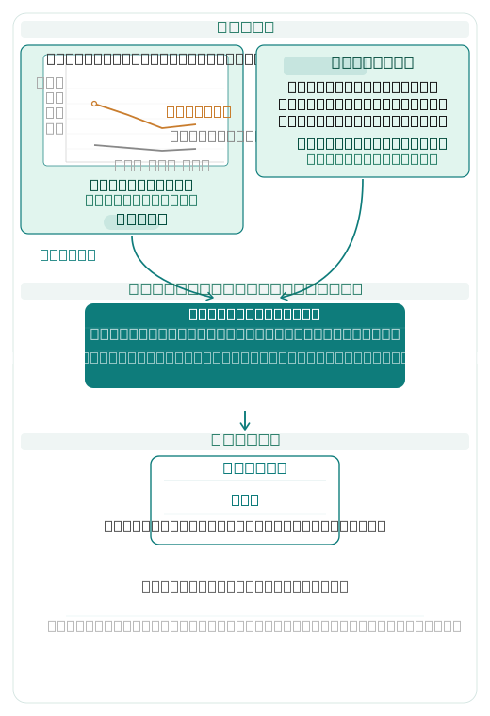
Introduction
Chart Question Answering
Chart question answering (Chart QA) is the task of answering natural language questions about information encoded in chart images.
Visual chart understanding task
Answer questions directly from chart images
Benefits
No manual data annotation needed
Works across chart types & domains
2
1

Slide 3
Objectives
To prevent reasoning collapse and improve generalization to out-of-distribution charts
To eliminate hallucinated reasoning by grounding every inference step in chart-extracted values
To design a hierarchical reward that enforces extraction consistency while encouraging reasoning diversity
To investigate how policy update strategies like GRPO, NSR, and W-REINFORCE affect reasoning diversity in chart-trained VLMs
To evaluate in-domain accuracy and out-of-distribution generalization under the proposed framework
To evaluate the proposed framework against existing chart reasoning baselines on standard benchmarks
3

Slide 4
Problem Statement
Developing a reinforcement learning framework that learns to map a chart image and a natural language question to a faithful reasoning chain and a correct answer , rewarding only responses where every reasoning step is grounded in values extracted from the chart, while eliminating hallucination and ensuring robustness to out-of-distribution charts.
Formally, given a chart image I and a question Q, we learn a mapping M(I, Q) → (R, A), where R = {r₁, ..., rₜ} is the reasoning chain and A is the final answer, such that A is correct with respect to I and every rᵢ ∈ R is grounded in values extracted from I.
4

Slide 5
Background
Reinforcement learning optimizes a policy by maximizing cumulative rewards through trial and error
Rollouts are responses sampled from the model, evaluated and used to compute advantage how much better a response is relative to others
RLVR restricts rewards to verifiable, ground-truth correct answers no soft or approximate scoring
GRPO updates the policy by strongly reinforcing above-average rollouts and penalizing below-average ones
NSR preserves diversity by skipping correct samples entirely and only penalizing wrong ones
W-REINFORCE balances accuracy and diversity ,weak positive reinforcement for correct, strong penalty for wrong
5

Slide 6
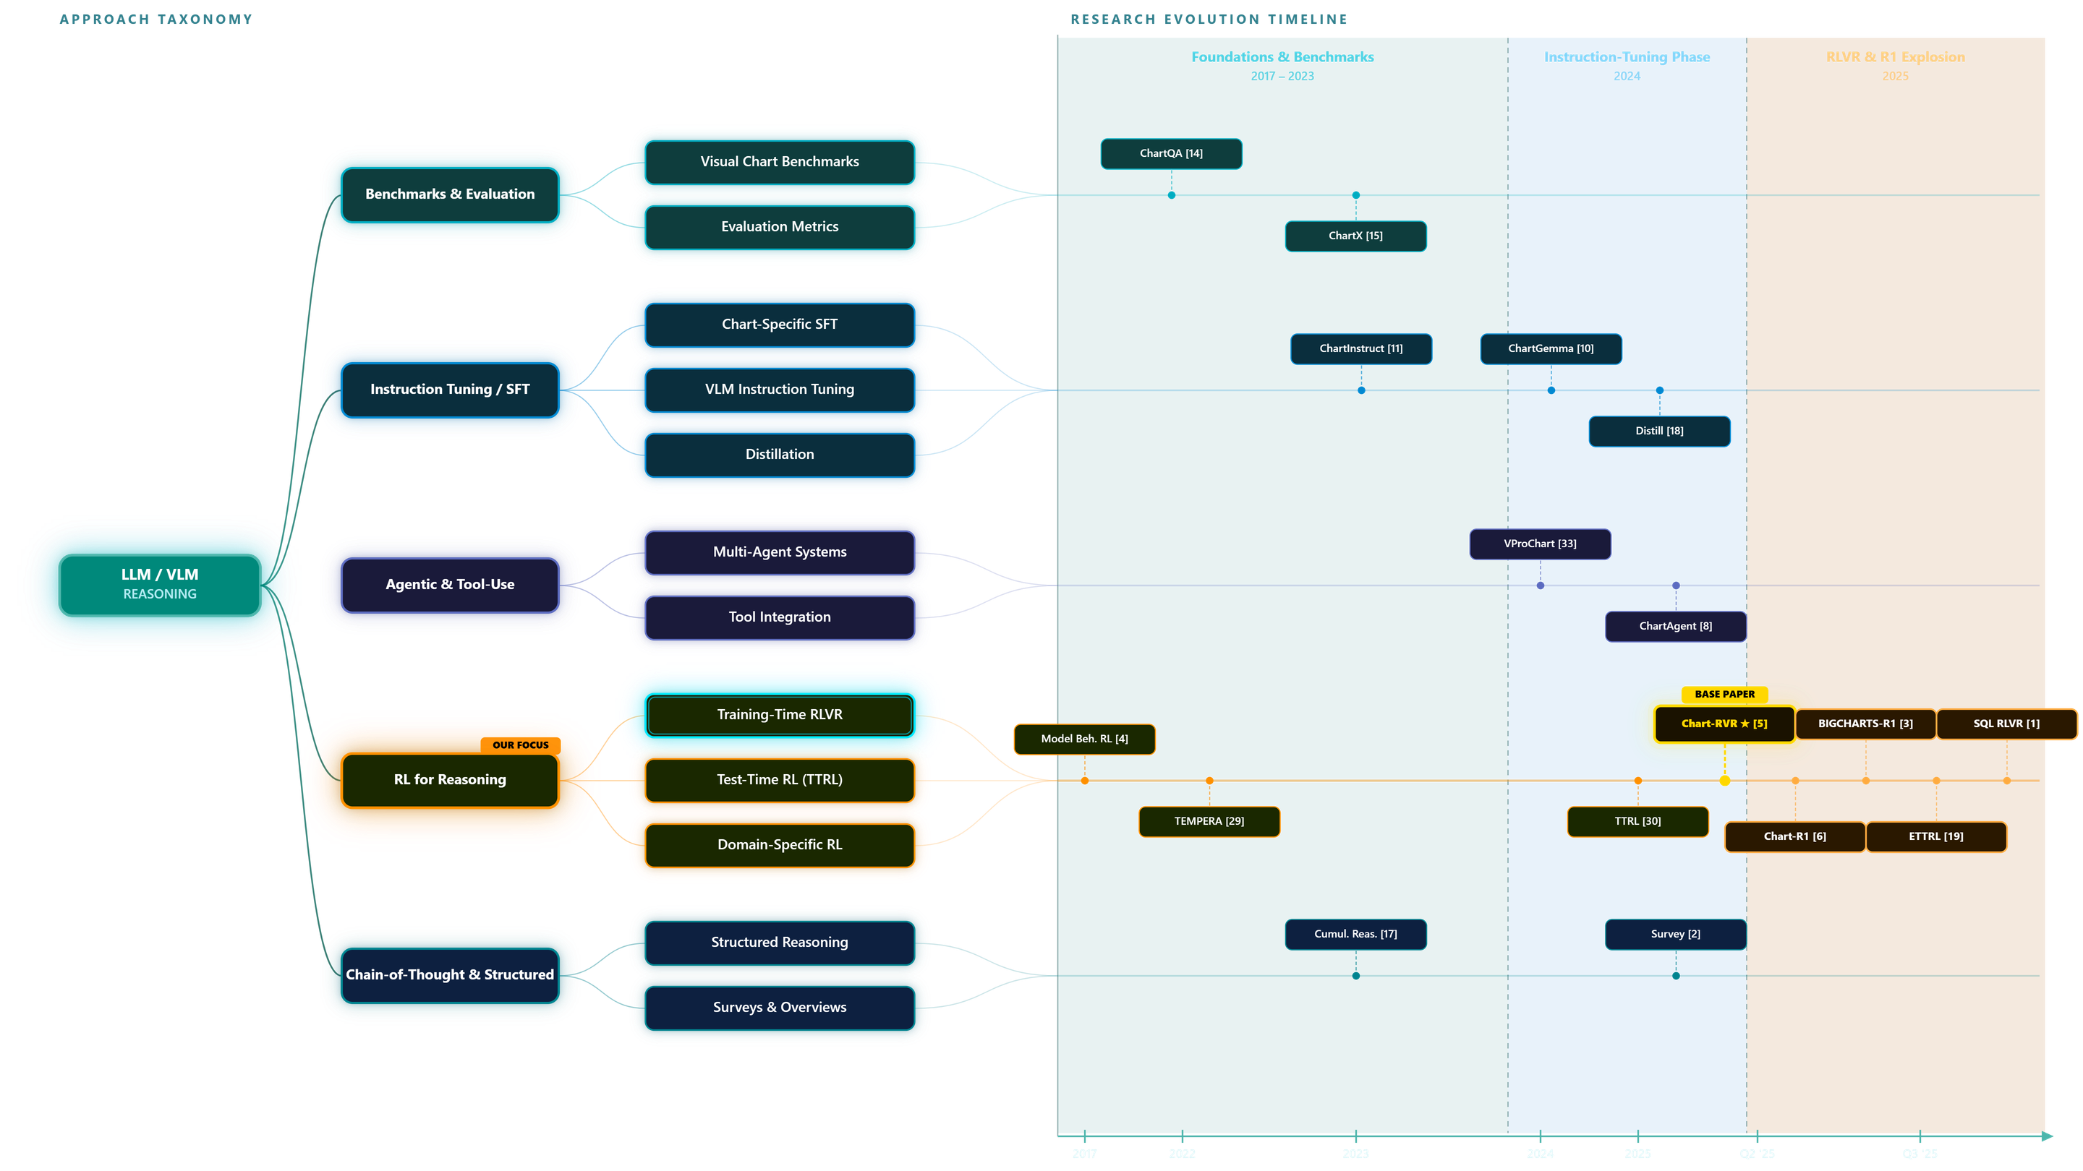
Literature Review
6
6

Slide 7
Literature Review
Benchmarks, SFT & Agentic Approaches
Visual Chart Benchmarks [14, 15, 22, 13]
Multi-Agent Systems [8, 9, 34, 23]
Curated QA pairs over diverse chart types with structured annotations
Evaluation split into perception (reading) and reasoning (inference) tasks
Queries decomposed across specialised planner, extractor, and reasoner agents
Agent coordination scaled dynamically with test-time compute allocation
Evaluation Metrics [14, 13]
Relaxed correctness tolerates numeric near-matches
Separate scoring for visual grounding vs. logical inference
Tool Integration [33, 28]
External solvers and retrievers called to ground numeric and factual answers
Programmatic reasoning separates chart reading from logical inference
Chart-Specific SFT [11, 7, 12]
chart instruction datasets used to fine-tune VLMs
Grounding and attention mechanisms injected
7

Slide 8
Literature Review
RL for Reasoning & Structured Methods
Training-Time RLVR [1,5, 6, 3, 26, 20, 16]
Test-Time RL (TTRL) [4, 29, 30, 19, 31]
Rule-based verifiable rewards replace labelled data, enabling reward-driven optimisation
GRPO trains chain-of-thought reasoning directly without supervised fine-tuning
Model weights or prompts updated at inference using self-generated reward signals
Entropy control balances exploration and exploitation during test-time updates
Evaluation Metrics [14, 13]
Chain-of-Thought & Structured Reasoning [17, 25, 24]
Relaxed correctness tolerates numeric near-matches
Separate scoring for visual grounding vs. logical inference
Sub-step verification and formal symbolic languages enforce interpretable reasoning chains
RL-generated traces consistently outperform supervised CoT on complex tasks
Domain-Specific RL [21, 27, 32]
Verifiable reward frameworks transferred to remote sensing, UI navigation, and long-horizon tasks
8

Slide 9
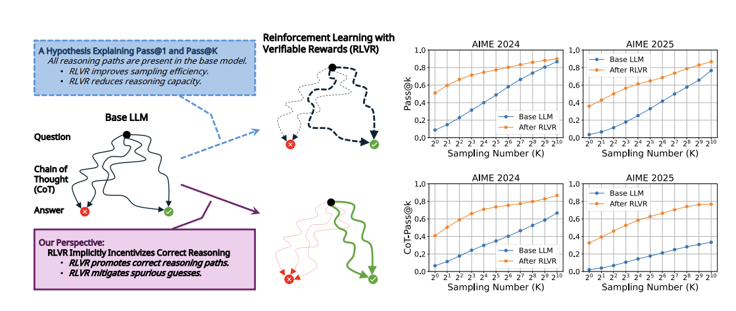
Literature Review
Reinforcement Learning with Verifiable Rewards Implicitly Incentivizes Correct Reasoning in Base LLMs
Xumeng Wen ,Zihan Liu ,Shun Zheng, Shengyu Ye, Zhirong Wu, Yang Wang, Zhijian Xu, Xiao Liang, Junjie Li , Ziming Miao, Jiang Bian, Mao Yang ICLR 2026
Pass@K fails to capture true reasoning quality, as base models often guess correctly through flawed CoTs. This paper introduces CoT-Pass@K requiring both correct reasoning and answers proving RLVR genuinely improves reasoning, not just sampling efficiency.
Contributions :
Introduces CoT-Pass@K : rewards only correct reasoning + correct answer
Proves RLVR improves CoT-Pass@K for all K
Correct reasoning emerges early in training
and generalizes to unseen questions
LLM-as-a-CoT-Judge proposed as scalable
automated CoT verifier
Drawbacks:
Doesn't guarantee generalization across all scenarios
Tested mainly on math
Pass@K degradation at large K reframed, not fixed
9

Slide 10
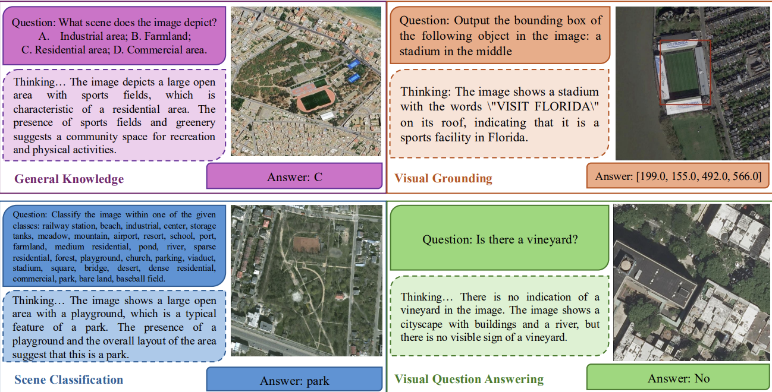
Literature Review
Few-Shot Vision-Language Reasoning for Satellite Imagery via Verifiable Rewards
Aybora Koksal, A. Aydin Alatan, ICCV 2025
Introduces the first few-shot RLVR framework for vision-language reasoning on satellite imagery, leveraging rule-based verifiable rewards to achieve competitive performance with minimal supervision eliminating the need for expensive caption annotations.
Contributions :
First RLVR framework for satellite imagery which does not need caption supervision
When carefully curated even 1-shot training yields significant gains over the base model.
General-purpose across multiple remote sensing tasks
Drawbacks:
Task-specific overfitting observed
Generalizability beyond satellite imagery unknown
10
5

Slide 11
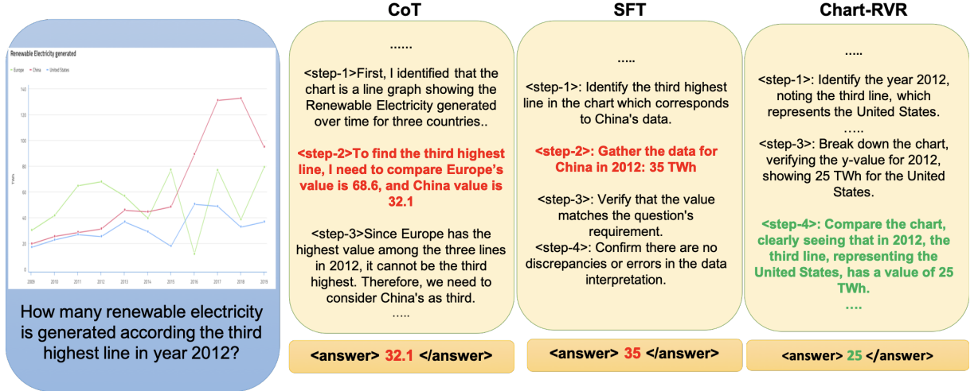
Literature Review
Chart-RVR: Reinforcement Learning with Verifiable Rewards for Explainable Chart Reasoning
Sanchit Sinha1, Oana Frunza , Kashif Rasul , Yuriy Nevmyvaka, Aidong Zhang, University of Virginia, Morgan Stanley
Chart-RVR introduces a GRPO-based reinforcement learning framework with three verifiable rewards : chart-type classification, table reconstruction, and process conformity to improve chart reasoning in vision-language models.
Contribution :
First general-purpose RL framework with verifiable surrogate-task rewards for chart reasoning
Outperforms SFT and vanilla GRPO
across 3 VLMs (Qwen2.5-VL, Gemma3,
InternVL-3.5)
Closes OOD performance gap, biggest
gains on EvoChart, ChartQAPro,
ChartBench
Produces more faithful, interpretable
CoT rationales
Drawbacks :
Process conformity reward relies on
an algorithmic skeleton
Restricted to chart reasoning
Requires ground-truth tables and chart types
Limited to 3B parameters
11
3

Slide 12
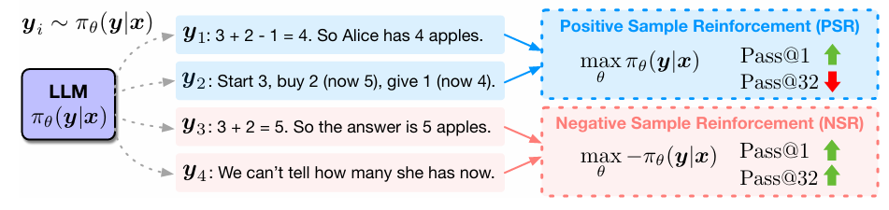
Literature Review
RLVR-Decomposed: The Surprising Effectiveness of Negative Reinforcement in LLM Reasoning
Xinyu Zhu, Mengzhou Xia, Zhepei Wei, Wei-Lin Chen, Danqi Chen, Yu Meng University of Virginia, Princeton University, NeurIPS 2025
RLVR-Decomposed trains models using reinforcement learning by decomposing the learning signal into positive and negative components, revealing that negative reinforcement alone can be surprisingly effective.
Contributions :
RLVR decomposed into two components PSR and NSR to study their individual effects.
NSR-only training matches/surpasses PPO & GRPO across full Pass@k spectrum
NSR preserves diversity by suppressing wrong answers and redistributing probability mass
Weighted-REINFORCE proposed which upweights NSR, beats PPO & GRPO on MATH, AIME 2025, AMC23
Drawbacks:
NSR only refines existing knowledge,
cannot teach new behaviors
PSR collapses output diversity, hurts performance at higher k
Tested only on math
No evaluation on visual or multimodal tasks
12
5

Slide 13
Research Challenges
Collective Disadvantages & Problems Across the discussed Papers
The limitations of the existing models :
Existing RLVR methods suffer from reasoning collapse and hallucination [Chart-RVR; CoT-Pass@K]
Standard evaluation metrics like Pass@K reward correct final answers regardless of reasoning validity, making RLVR appear ineffective when it is genuinely improving reasoning quality [CoT-Pass@K; RLVR-Decomposed]
Positive reinforcement destroys output diversity [RLVR-Decomposed; Chart-RVR]
Reward designs treat all reasoning levels uniformly, limiting robustness across visual domains [Chart-RVR, 2025]
13
5

Slide 14
Research Questions
What we are trying to address
Can RLVR, with only 1,000 training samples and a 3B-parameter VLM, produce meaningful improvements in chart QA accuracy and output structure?
This would establish whether RLVR is viable for visual reasoning under resource constraints.
Does reasoning-path-aware reward design outperform flat reward design?
Tests whether the path to the answer matters, not just the answer itself.
Can Negative Sample Reward (NSR), designed for text math, transfer to a vision-language model with multi-component rewards?
If NSR generalizes to VLMs, it opens a new class of training strategies for visual reasoning beyond our chart task
Is explicit diversity promotion competitive with implicit diversity preservation?
How does HCPC, which explicitly rewards diverse correct reasoning across rollouts, compare with NSR, which preserves diversity by withholding gradients from correct rollouts?
14
5

Slide 15
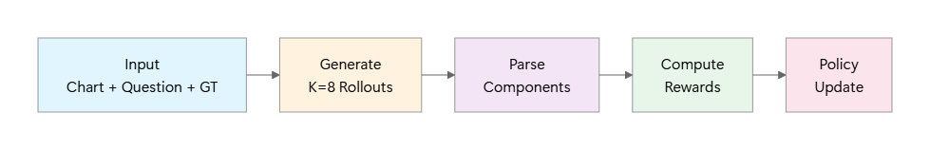
Proposed Methodology
Pipeline Overview
Step | Action | Output
1. Input | Chart image + Question + Ground truth (type, table, answer) | Training sample
2. Generation | Generate K=8 rollouts | 8 candidate responses
3. Parsing | Extract type, table, reasoning, answer from each rollout | Structured components
4. Filtering | Identify fully correct rollouts (match GT type, table, answer) | Correct set for HCPC
5. Rewards | Compute R_base + R_HCPC + R_CLC | Per-sample total reward
6. Advantages | Method-dependent (GRPO/NSR/W-REINFORCE) | Gradient weights
7. Update | Policy gradient step | Updated model θ
15
5

Slide 16
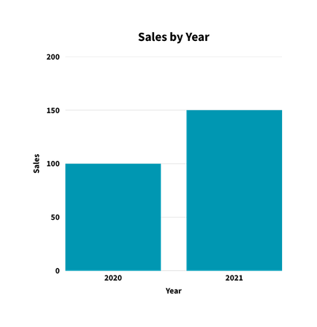
Proposed Methodology - Pipeline Diagram
1.INPUT
2.MULTI RESPONSE GENERATION
(K=8)
3.PARSE EACH RESPONSE
4.FILTER
Chart Image
Correct chart type
Extract
chart type
table
reasoning
answer
Correct final answer
R1
Type : bar Table: {2020:100, 2021:150}
Reasoning: 100 + 150 = 250
Answer: 250
Table Accuracy ≥ 0.8
Type : Pie Table : {2020:100, 2021:150}
Reasoning: Sum two numbers → 240
Answer: 240
R2
CLC
.
For each Rollouts
{R1, R4}
.
R_BASE
All referenced value appear in the table
No hallucination numbers
Logical Coherence maintained
.
.
Type : bar Table : {2020:95, 2021:155}
Reasoning: 95 + 155 = 250
Answer: 250
For each Response:
Question
R8
chart Type + Table + Answer Accuracy
HCPC
What is the total sales for 2020 and 2021?
Table Consistency
Reasoning Diversity
type : bar
table : { 2020:100, 2021:150 }
answer : 250
All FC have accurate table data
Distinct reasoning among FC
Ground Truth
Iterate over epochs
Score: x
Score: y
6.POLICY UPDATE
HCPC Score : w2 . x.0 + w3 . y
GRPO
NSR
W- REINFORCE
7.FINAL PREDICTION
Strong boost for high reward, penalize low
Skip correct samples, penalize wrong ones
Weak boost(λ = 0.1) , strong penalize
5.REWARD AGGREGATION
Total Sales = 250
R_total = R_base + λ₁·HCPC + λ₂·CLC
16
11
Notes:
This is a pipeline diagram of our training methodology

Slide 17
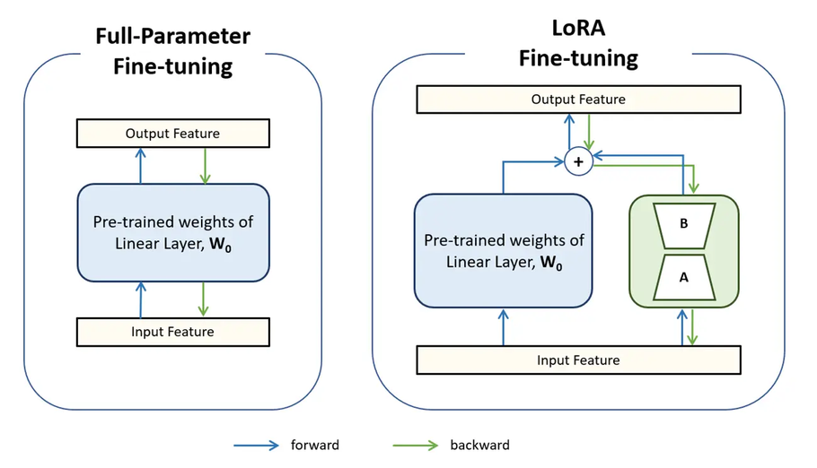
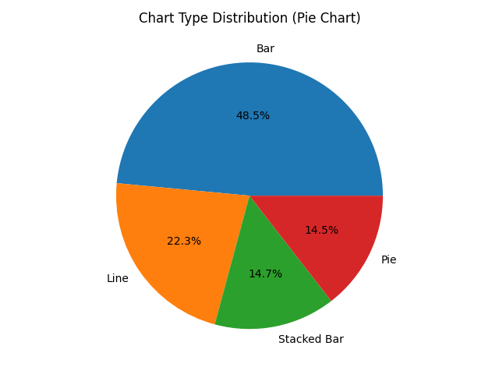
Experimental Setup
Environment
Model: Qwen2.5-VL-3B-Instruct
Platforms Used: Kaggle and Local PC
Hardware:
NVIDIA RTX 3090 24GB VRAM (Local PC)
Training Dataset — Chart-RVR GRPO Train [15]
Full dataset: 34,194 samples (ChartQA, PlotQA)
Subset used: 1,000 samples - random sampling
Test Dataset — Chart-RVR GRPO Test [15]
Total Samples Evaluated — 500
In Distribution: ChartQA, PlotQA
Out of Distribution: ChartFC
17
21
Notes:
The first thing that jumps out is accuracy. The base model, with no training at all, gets 51.8%. GRPO pushes that to 63%. GRPO-HCPC lands at 62.2% — nearly identical to GRPO. Replacing the process reward with a fundamentally different group-level objective costs us less than one percentage point of accuracy.
But the more interesting story is in pass at k. Pass at k asks: if you sample k responses, what is the probability that at least one of K rollouts provide the correct answer? At k equals four, GRPO scores 80.3%. GRPO-HCPC scores 82.8%. it says the model's candidate set is more reliably correct.

Slide 18
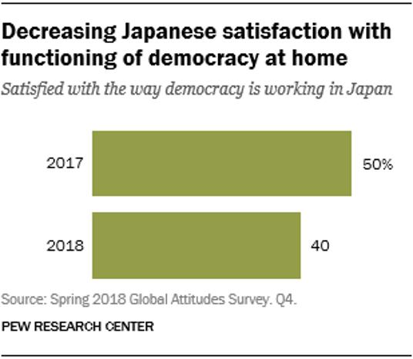
Experimental Setup
Dataset Samples
Output Format
System Prompt
You are given a chart image and a query about the chart.
Think step-by-step about how to answer the query based on the chart image and then provide the final answer...
<type> Bar </type>
<table>
{
"columns": ["Year", "Percentage"],
"rows": [
["2017", "50"],
["2018", "40"] ]
}
</table>
<think>
<step-1>: The question asks for ... ...
<step-2>: From the chart: 2017 = 50%, 2018 = 40%.
<step-3>: We need to calculate the difference.
<step-4>: The difference is 50% − 40% = 10%.
<step-5>: Values taken directly from chart. Verified.
</think>
Query
The difference between 2017 and 2018 in the percentage of Japanese satisfaction with democracy is what percentage?
Ground Truth : 10
<answer> 10 </answer>
18
21
Notes:
The first thing that jumps out is accuracy. The base model, with no training at all, gets 51.8%. GRPO pushes that to 63%. GRPO-HCPC lands at 62.2% — nearly identical to GRPO. Replacing the process reward with a fundamentally different group-level objective costs us less than one percentage point of accuracy.
But the more interesting story is in pass at k. Pass at k asks: if you sample k responses, what is the probability that at least one of K rollouts provide the correct answer? At k equals four, GRPO scores 80.3%. GRPO-HCPC scores 82.8%. it says the model's candidate set is more reliably correct.

Slide 19
Results
Performance Evaluation — Experiment List
Exp. ID | Experiment | Method(s) | Purpose
E0 | Base model evaluation | Qwen2.5-VL-3B-Instruct | Establish zero-training baseline
E1 | Standard RLVR baseline | GRPO | Test whether flat verifiable rewards improve chart QA
E2 | Proposed HCPC reward | GRPO+HCPC | Test hierarchical correct-path consistency vs flat GRPO
E3 | Negative-only reinforcement baseline | NSR | Test whether text-only NSR transfers to VLM chart reasoning and compare with GRPO-HCPC
E4 | OOD fact-checking transfer | GRPO, GRPO+HCPC, NSR | Test distribution shift from ChartQA-style QA to chart fact-checking
19
21
Notes:
The first thing that jumps out is accuracy. The base model, with no training at all, gets 51.8%. GRPO pushes that to 63%. GRPO-HCPC lands at 62.2% — nearly identical to GRPO. Replacing the process reward with a fundamentally different group-level objective costs us less than one percentage point of accuracy.
But the more interesting story is in pass at k. Pass at k asks: if you sample k responses, what is the probability that at least one of K rollouts provide the correct answer? At k equals four, GRPO scores 80.3%. GRPO-HCPC scores 82.8%. it says the model's candidate set is more reliably correct.

Slide 20
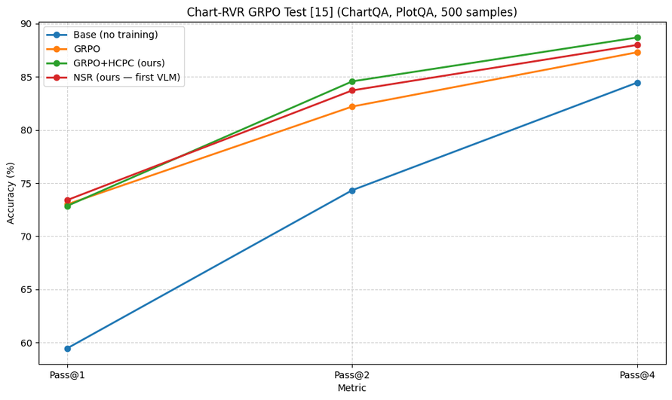
Results
Performance Evaluation
Chart-RVR GRPO Test [15] (ChartQA, PlotQA, 500 samples)
Method | Pass@1 | Pass@2 | Pass@4
Base (no training) | 59.45 | 74.33 | 84.46
GRPO | 73 | 82.2 | 87.31
GRPO+HCPC (ours) | 72.85 | 84.57 | 88.70
NSR (ours — first VLM) | 73.4 | 83.72 | 88.00
20
21
Notes:
The first thing that jumps out is accuracy. The base model, with no training at all, gets 51.8%. GRPO pushes that to 63%. GRPO-HCPC lands at 62.2% — nearly identical to GRPO. Replacing the process reward with a fundamentally different group-level objective costs us less than one percentage point of accuracy.
But the more interesting story is in pass at k. Pass at k asks: if you sample k responses, what is the probability that at least one of K rollouts provide the correct answer? At k equals four, GRPO scores 80.3%. GRPO-HCPC scores 82.8%. it says the model's candidate set is more reliably correct.

Slide 21
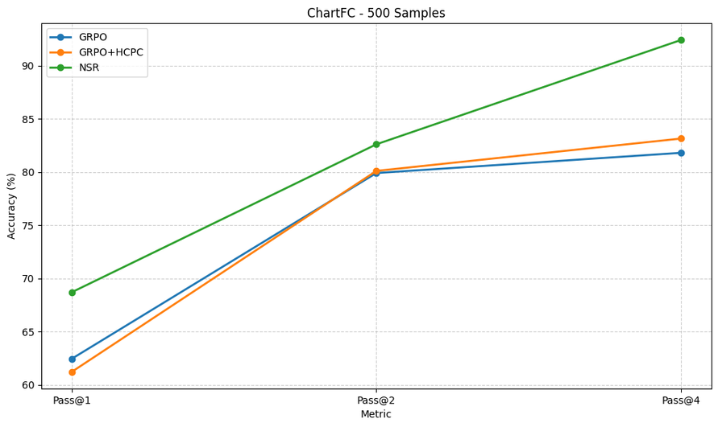
Results
Performance Evaluation
ChartFC - 500 Samples
Method | Pass@1 | Pass@2 | Pass@4
GRPO | 62.45 | 79.9 | 81.8
GRPO+HCPC | 61.22 | 80.1 | 83.14
NSR | 68.70 | 82.60 | 92.40
21
21
Notes:
The first thing that jumps out is accuracy. The base model, with no training at all, gets 51.8%. GRPO pushes that to 63%. GRPO-HCPC lands at 62.2% — nearly identical to GRPO. Replacing the process reward with a fundamentally different group-level objective costs us less than one percentage point of accuracy.
But the more interesting story is in pass at k. Pass at k asks: if you sample k responses, what is the probability that at least one of K rollouts provide the correct answer? At k equals four, GRPO scores 80.3%. GRPO-HCPC scores 82.8%. it says the model's candidate set is more reliably correct.

Slide 22
Conclusion and Future Plan
What We Did
HCPC (Hierarchical Correct-Path Consistency): A cross-rollout reward bonus that rewards consistent table extraction and diverse reasoning — conditioned on correctness of intermediate steps, not just final answers
NSR applied to VLMs for the first time: Extends negative-only reinforcement [32] to vision-language models with noisy, multi-component rewards. Used here as a competitive baseline to test whether implicit diversity preservation (withholding gradients on correct rollouts) can match explicit diversity engineering (HCPC).
Limitations &Future Plans
Model scale and recency —Extending to larger parameter regimes (7B, 72B), Conducting experiments with K = 8.
Full training corpus — Current results are based on a 1,000-sample subset of the 34,194-sample Chart-RVR dataset.
Implement CLC and NSR-HCPC Pipelines — Add CLC reward and NSR-HCPC reward in pipeline to enhance reasoning robustness, consistency, and alignment with desired outputs.
Entropy-based reasoning diversity — A principled alternative is to directly regularize the entropy of the rollout distribution during training, enabling explicit, continuous control over diversity without dependence on surface-level textual overlap.
Out-of-distribution robustness — Investigate domain-adaptive training strategies and evaluate across a broader range of chart distributions.
22
21
Notes:
The first thing that jumps out is accuracy. The base model, with no training at all, gets 51.8%. GRPO pushes that to 63%. GRPO-HCPC lands at 62.2% — nearly identical to GRPO. Replacing the process reward with a fundamentally different group-level objective costs us less than one percentage point of accuracy.
But the more interesting story is in pass at k. Pass at k asks: if you sample k responses, what is the probability that at least one of K rollouts provide the correct answer? At k equals four, GRPO scores 80.3%. GRPO-HCPC scores 82.8%. it says the model's candidate set is more reliably correct.

Slide 23
References
[1] Ali, A., Baheti, A., Chang, J., Chi, T.-C., Cui, B., Drozdov, A., Frankle, J., Gupta, A., Koppol, P., Kulinski, S., Li, J., Misra, D., Opsahl-Ong, K., Ortiz, J. J. G., Zaharia, M., & Zhang, Y. (2025). A state-of-the-art SQL reasoning model using RLVR. arXiv. https://arxiv.org/abs/2509.21459
[2] Ke, Z., Jiao, F., Ming, Y., Nguyen, X.-P., Xu, A., Long, D. X., Li, M., Qin, C., Wang, P., Savarese, S., Xiong, C., & Joty, S. (2025). A survey of frontiers in LLM reasoning: Inference scaling, learning to reason, and agentic systems. Transactions on Machine Learning Research. https://arxiv.org/abs/2504.09037
[3] Masry, A., Puri, A., Hashemi, M., Rodriguez, J. A., Thakkar, M., Mahajan, K., Yadav, V., Madhusudhan, S. T., Piché, A., Bahdanau, D., Pal, C., Vazquez, D., Hoque, E., Taslakian, P., Rajeswar, S., & Gella, S. (2025). BIGCHARTS-R1: Enhanced chart reasoning with visual reinforcement finetuning. COLM. https://arxiv.org/abs/2508.09804
[4] Odena, A., Lawson, D., & Olah, C. (2017). Changing model behavior at test-time using reinforcement learning. ICLR Workshop. https://arxiv.org/abs/1702.07780
[5] Sinha, S., Frunza, O., Rasul, K., Nevmyvaka, Y., & Zhang, A. (2025). Chart-RVR: Reinforcement learning with verifiable rewards for explainable chart reasoning. arXiv. https://arxiv.org/abs/2510.10973
[6] Chen, L., Zhao, X., Zeng, Z., Huang, J., Zhong, Y., & Ma, L. (2025). Chart-R1: Chain-of-thought supervision and reinforcement for advanced chart reasoner. arXiv. https://arxiv.org/abs/2507.15509
[7] Carbune, V., Mansoor, H., Liu, F., Aralikatte, R., Baechler, G., Chen, J., & Sharma, A. (2024). Chart-based reasoning: Transferring capabilities from LLMs to VLMs. NAACL Findings. https://aclanthology.org/2024.findings-naacl.62/
[8] Kaur, R., Srishankar, N., Zeng, Z., Ganesh, S., & Veloso, M. (2025). ChartAgent: A multimodal agent for visually grounded reasoning in complex chart question answering. arXiv. https://arxiv.org/abs/2510.04514
[9] Goswami, K., Mathur, P., Rossi, R., & Dernoncourt, F. (2025). ChartCitor: Answer citations for ChartQA via multi-agent LLM retrieval. ACM Web Conference. https://doi.org/10.1145/3701716.3716886
[10] Masry, A., Thakkar, M., Bajaj, A., Kartha, A., Hoque, E., & Joty, S. (2025). ChartGemma: Visual instruction-tuning for chart reasoning in the wild. COLING Industry Track. https://arxiv.org/abs/2407.04172
[11] Masry, A., Shahmohammadi, M., Parvez, M. R., Hoque, E., & Joty, S. (2024). ChartInstruct: Instruction tuning for chart comprehension and reasoning. ACL Findings. https://aclanthology.org/2024.findings-acl.619/
[12] Xu, Z., Du, S., Qi, Y., Lu, S., Xu, C., Yuan, C., & Guo, J. (2025). ChartPoint: Guiding MLLMs with grounding reflection for chart reasoning. ICCV. https://arxiv.org/abs/2512.00305
[13] Hegde, S., Fazli, P., & Seifi, H. (2026). ChartQA-X: Generating explanations for visual chart reasoning. WACV. https://arxiv.org/abs/2504.13275
[14] Masry, A., Long, D. X., Tan, J. Q., Joty, S., & Hoque, E. (2022). ChartQA: A benchmark for question answering about charts with visual and logical reasoning. ACL Findings. https://aclanthology.org/2022.findings-acl.177/
23
21
Notes:
The first thing that jumps out is accuracy. The base model, with no training at all, gets 51.8%. GRPO pushes that to 63%. GRPO-HCPC lands at 62.2% — nearly identical to GRPO. Replacing the process reward with a fundamentally different group-level objective costs us less than one percentage point of accuracy.
But the more interesting story is in pass at k. Pass at k asks: if you sample k responses, what is the probability that at least one of K rollouts provide the correct answer? At k equals four, GRPO scores 80.3%. GRPO-HCPC scores 82.8%. it says the model's candidate set is more reliably correct.

Slide 24
References
[15] Xia, R., Zhang, B., Ye, H., Yan, X., Liu, Q., Zhou, H., Chen, Z., Dou, M., Shi, B., Yan, J., & Qiao, Y. (2024). ChartX and ChartVLM: A versatile benchmark and foundation model for complicated chart reasoning. IEEE Transactions on Image Processing. https://arxiv.org/abs/2402.12185
[16] Su, Y., Yu, D., Song, L., Li, J., Mi, H., Tu, Z., Zhang, M., & Yu, D. (2025). Crossing the reward bridge: Expanding RL with verifiable rewards across diverse domains. arXiv. https://arxiv.org/abs/2503.23829
[17] Zhang, Y., Yang, J., Yuan, Y., & Yao, A. C.-C. (2024). Cumulative reasoning with large language models. TMLR. https://arxiv.org/abs/2308.04371
[18] He, W., Xi, Z., Zhao, W., Fan, X., Ding, Y., Shan, Z., Gui, T., Zhang, Q., & Huang, X. (2025). Distill visual chart reasoning ability from LLMs to MLLMs. EMNLP Findings. https://aclanthology.org/2025.findings-emnlp.172/
[19] Liu, J., He, C., Lin, Y., Yang, M., Shen, F., Liu, S., & Gao, T. (2025). ETTRL: Balancing exploration and exploitation in LLM test-time RL via entropy mechanism. arXiv. https://arxiv.org/abs/2508.11356
[20] Su, Y., et al. (2025). Expanding RL with verifiable rewards across diverse domains. arXiv. https://arxiv.org/abs/2503.23829
[21] Köksal, A., & Alatan, A. A. (2025). Few-shot vision-language reasoning for satellite imagery via verifiable rewards. ICCV. https://arxiv.org/abs/2507.21745
[22] Teney, D., Liu, L., & van den Hengel, A. (2017). Graph-structured representations for visual question answering. CVPR. https://arxiv.org/abs/1609.05600
[23] Duan, W., Lu, J., & Xuan, J. (2024). Group-aware coordination graph for multi-agent reinforcement learning. IJCAI. https://doi.org/10.24963/ijcai.2024/434
[24] Zhang, R., et al. (2025). Improve vision-language model chain-of-thought reasoning. ACL. https://aclanthology.org/2025.acl-long.82/
[25] Lu, P., Gong, R., Jiang, S., Qiu, L., Huang, S., Liang, X., & Zhu, S.-C. (2021). Inter-GPS: Interpretable geometry problem solving with formal language and symbolic reasoning. ACL-IJCNLP. https://aclanthology.org/2021.acl-long.528/
[26] Wen, X., et al. (2025). Reinforcement learning with verifiable rewards implicitly incentivizes correct reasoning in base LLMs. arXiv. https://arxiv.org/abs/2506.14245
[27] Zhang, Z., et al. (2025). RLVMR: Reinforcement learning with verifiable meta-reasoning rewards. arXiv. https://arxiv.org/abs/2507.22844
[28] Akhtar, M., Cocarascu, O., & Simperl, E. (2023). Reading and reasoning over chart images for evidence-based fact-checking. EACL Findings. https://aclanthology.org/2023.findings-eacl.30/
[29] Zhang, T., et al. (2023). TEMPERA: Test-time prompt editing via reinforcement learning. ICLR. https://arxiv.org/abs/2211.11890
[30] Zuo, Y., et al. (2025). TTRL: Test-time reinforcement learning. arXiv. https://arxiv.org/abs/2504.16084
[31] Du, Y., et al. (2025). Test-time reinforcement learning for GUI grounding via region consistency. arXiv. https://arxiv.org/abs/2508.05615
[32] Zhu, X., et al. (2025). The surprising effectiveness of negative reinforcement in LLM reasoning. NeurIPS. https://arxiv.org/abs/2506.01347
[33] Huang, M., et al. (2025). VProChart: Answering chart question through visual perception alignment agent and programmatic reasoning. AAAI. https://doi.org/10.1609/aaai.v39i4.32384
[34] Yu, X., et al. (2025). Visual document understanding and reasoning: A multi-agent collaboration framework with adaptive test-time scaling. arXiv. https://arxiv.org/abs/2508.03404
24
21
Notes:
The first thing that jumps out is accuracy. The base model, with no training at all, gets 51.8%. GRPO pushes that to 63%. GRPO-HCPC lands at 62.2% — nearly identical to GRPO. Replacing the process reward with a fundamentally different group-level objective costs us less than one percentage point of accuracy.
But the more interesting story is in pass at k. Pass at k asks: if you sample k responses, what is the probability that at least one of K rollouts provide the correct answer? At k equals four, GRPO scores 80.3%. GRPO-HCPC scores 82.8%. it says the model's candidate set is more reliably correct.

Slide 25
Thank You
25

